Slide 1


Ch 01 Basic Concepts of Medical Instrumentation

Slide 2
1.1 Terminology of Medicine and Medical Devices
Type | Dictionary | Homepage
English-Chinese Medical Dictionary | 榮陽數位化醫學字典 由台北榮民總醫院及陽明大學合作建立的數位化醫學辭典。可查詢中文及英文醫學字彙。 | http://libs2.vghtpe.gov.tw/digital_new/portal_d1.php?button_num=d1
English-Chinese Dictionary | YAHOO奇摩字典 | https://tw.dictionary.yahoo.com/
English-Indonessian Medical Dictionary | (To be found) | (To be found)

Slide 3
1.2 Generalized Medical Instrumentation System

Slide 4
Figure 1.1 Generalized instrumentation system
The sensor converts energy or information from the measurand to another form (usually electric).
This signal is the processed and displayed so that humans can perceive the information.
Elements and connections shown by dashed lines are optional for some applications.
Control
And
feedback
Power
Sensor
source
Perceptible
output
Primary
Sensing
element
Variable
Conversion
element
Signal
processing
Output
display
Measurand
(Transducer)
(Display, printer, etc.)
Calibration
Data
storage
Data
transmission
signal
Radiation,
electric current,
or other applied
energy

Slide 5
Measurand
Accessibility | Internal On body surface Emanate from the body Derived from a tissue sample
Categories | Biopotential Pressure Flow Dimension Imaging Displacement (velocity, acceleration, force) Impedance Temperature Chemical concentration
Measurand = A quantity that is to be measured.
McGraw-Hill Dictionary of Scientific & Technical Terms, 6E, Copyright © 2003 by The McGraw-Hill Companies, Inc.

Slide 6
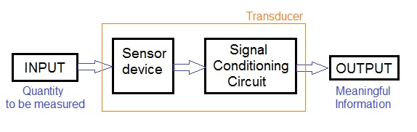
Sensor and transducer
Transducer : energy 1 → energy 2
e.g., (ECG ) ionic signal → electronic signal
https://www.rfwireless-world.com/Terminology/Sensor-vs-Transducer.html

Slide 7
1.3 Alternative Operational Modes
Direct-indirect modes
Direct: The measurand is accessible.
Indirect: The measurand is inaccessible. E.g.: cardiac output (blood volume/min from the heart), morphology of internal organs, pulmonary volume
Cardiac : heart
Sampling and continuous modes
Can be sampled infrequently: e.g., body temperature, ion concentration
Must be monitored continuously: e.g., respiratory gas flow, ECG
Generating and modulating sensors
Generating sensors: produce their signal output from energy taken directly from the measurand; e.g., photovoltaic cell
* Modulating sensors: use the measurand to alter the flow of energy from an external source in a way that affects the output of the sensor; e.g., photoconductive cell
Analog and digital modes
* Analog: able to take on any value within the dynamic range
* Digital: accuracy, repeatability, reliability, noise-immunity, not requiring periodic calibration
Real-time and delayed-time modes
Acquire or display the result in real time: when urgent feedback and control tasks depend on the output
Acquire or display the result in delayed time: e.g. cell culture

Slide 8
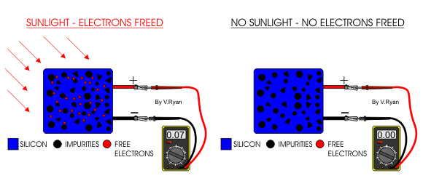
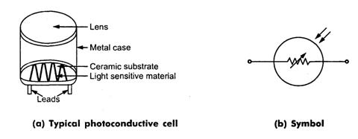
Generating vs. modulating
photovoltaic cell vs. photoconductive cell
Generating
Modulating
Source: http://www.technologystudent.com/energy1/solar5.htm
Source: http://allineee.blogspot.tw/2011_09_01_archive.html

Slide 9
1.4 Medical Measurement Constraints
Biomedical signal parameters ---- low (compared with nonbiomedical ones)
e.g., potential = μV−mV
frequency = DC−100 Hz
pressure ~ 100 mm Hg
Inaccessibility of many crucial variables in living systems
e.g., cardiac output is quite inaccessible.
Physical sizes of many sensors --- prohibits the formation of a proper measurand−sensor interface
Is it good to be this low?
Is it good to be this low?
Difficult to establish safe level of energy (e.g., X-ray, ultrasound, etc.)
-- many mechanisms of tissue damage are not well understood.
-- heating of tissue must be limited (I^2 * R = V^2/R)
-- Damage to tissue at molecular level can be caused at surprisingly low energy levels.
Operation of instruments in the medical environment imposes important constrains
-- Equipment must be reliable, easy to operate, and capable of withstanding physical abuse and exposure to corrosive chemicals
-- Electronic equipment must be designed to minimize electric-shock hazards
-- must consider the safety of patients and medical personnel

Slide 10
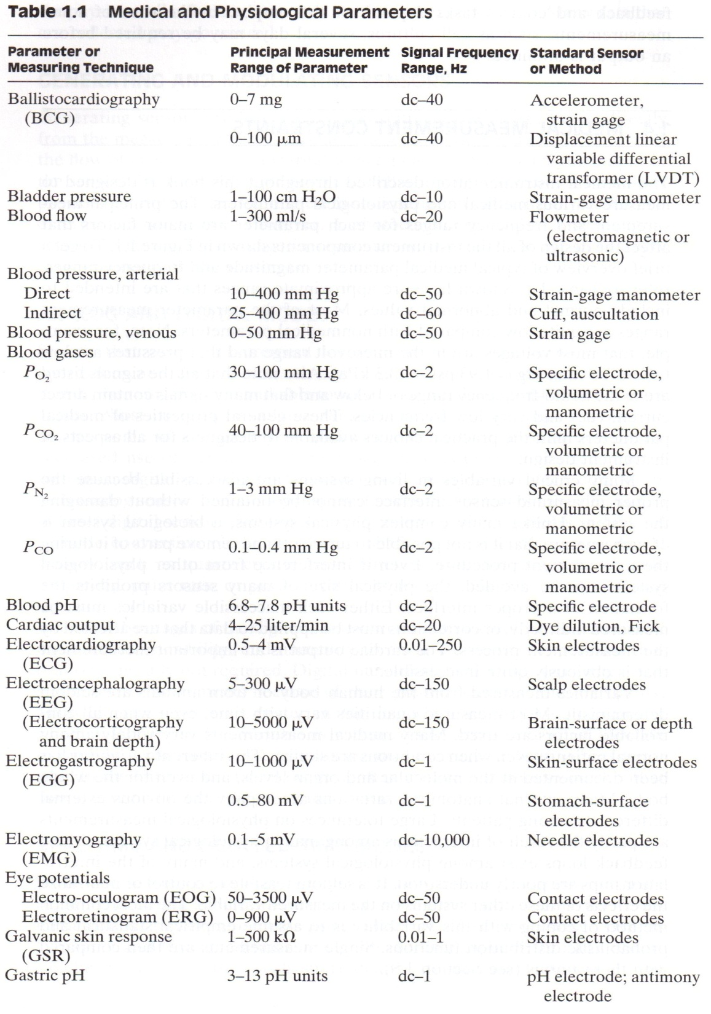
hk
Ballistic = 彈道的
Gastric = 胃的
Antimony = Sb, 銻
ballistocardiography
心臟射出容量記錄
Manometer 壓力計

Slide 11
a change in the electrical resistance of the skin occurring in moments of strong emotion; measurements of this change are used in lie detector tests GSR
galvanic skin response definition
Function:
: a change in the electrical resistance of the skin that is a physiochemical response to emotional arousal which increases sympathetic nervous system activity — abbreviation GSR
Merriam-Webster's Medical Dictionary, © 2007 Merriam-Webster, Inc.
Source:
Dictionary.com, "galvanic skin response," in Merriam-Webster's Medical Dictionary. Source location: Merriam-Webster, Inc. http://dictionary.reference.com/browse/galvanic skin response. Available: http://dictionary.reference.com. Accessed: February 23, 2011.

Slide 12
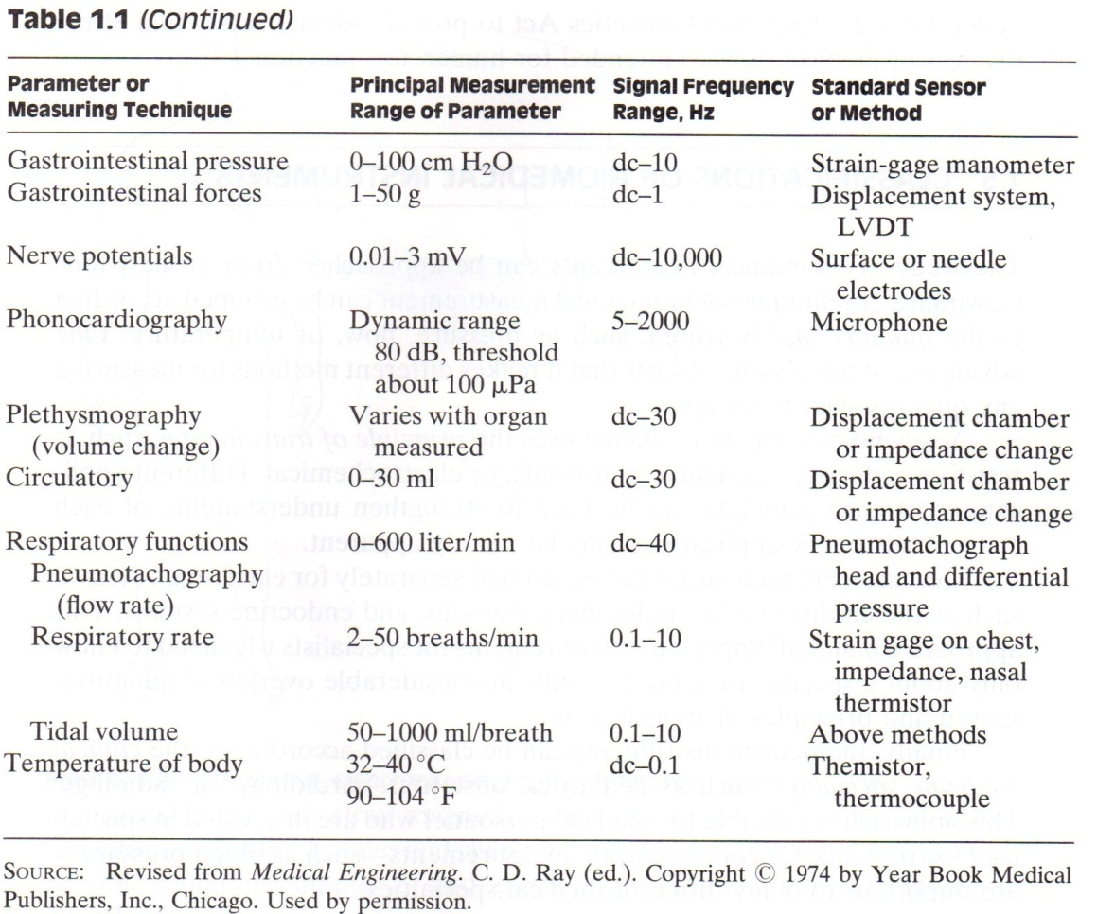
s
Gastrointestinal 胃與腸的
Pneumotachography 呼吸氣速度描記.
pneumo- or pneum- pref.
1. Air; gas: pneumothorax 氣胸.
2. Lung; pulmonary: pneumoconiosis 塵肺病.
3. Respiration: pneumography a.肺解剖學. b.呼吸運動描記法. c.充氣X光線照像. Pneumotachography 呼吸氣速度描記.
4. Pneumonia: pneumococcus 肺炎雙球菌,

Slide 13
Variability of measured quantities:
with time,
among patients, internal anatomy,
interactions among physiological systems,
feedback loops,
internal variability (at molecular and organ levels), …
To cope variability → use assume empirical statistical and probabilistic distribution functions

Slide 14
1.5 Classification of Biomedical Instruments
Different classifications:
According to what? | Examples
Quality that is sensed | Pressure, flow, temperature, potential, motion, chemical concentration, chemical reaction, etc.
Transduction (Converting one energy type to another one ) | Resistive (I → V), inductive (di/dt -> V ), capacitive (V → Q), ultrasonic (structure or motion → ultrasound) , electrochemical (concentration → electrochemical reaction)
Organ system | Cardiovascular (心血管), pulmonary (胸腔), nervous, endocrine (內分泌)
Clinical medicine specialties | Pediatrics (小兒科), obstetrics (產科), Gynecology (婦科), cardiology (心臟科), radiology
C
R = V/I; L =V/(di/dt); C = Q/V

Slide 15
1.6 Interfering and Modifying Inputs

Slide 16
Figure 1.2 Simplified electrocardiographic recording system
Two possible interfering inputs are stray magnetic fields and capacitively coupled noise.
Orientation of patient cables and changes in electrode-skin impedance are two possible modifying inputs.
Z₁ and Z₂ represent the electrode-skin interface impedances.
Electrodes
v_{ecg}
60-Hz
ac magnetic
field
+
V_{cc}
Z₁
Z_{body}
Z₂
+
Differential
amplifier
v_{o}
−
Displacement
currents
-V_{cc}

Slide 17
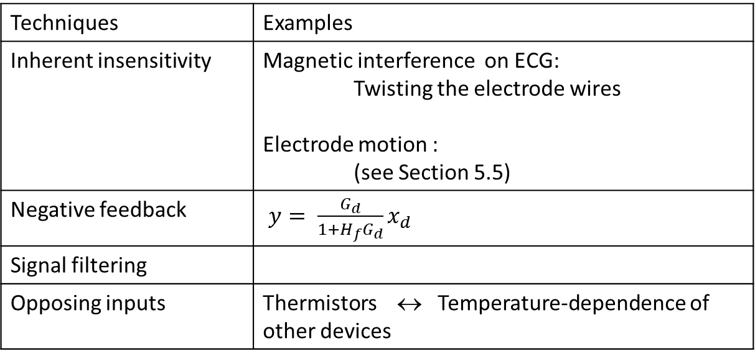
1.7 Compensation Techniques
How to reduce or eliminate the effects of interfering and modifying inputs
Techniques | Examples
Inherent insensitivity | Magnetic interference on ECG: Twisting the electrode wires Electrode motion : (see Section 5.5)
Negative feedback | $y= \frac{G_{d}}{1+H_{f}G_{d}}x_{d}$
Signal filtering
Opposing inputs | Thermistors ↔ Temperature-dependence of other devices

Slide 18
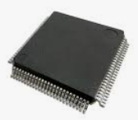
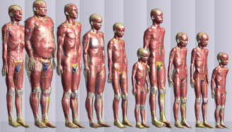
1.8 Biostatistics
• • •
vs.
https://itis.swiss/virtual-population/virtual-population/overview/

Slide 19

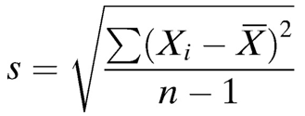

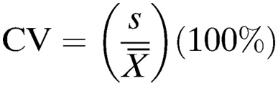
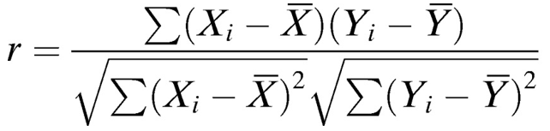

Slide 20
1.9 Generalized Static Characteristics
Static characteristics： Input =DC or low-frequency
Dynamic characteristics：Input = AC
Characteristics
Accuracy
Precision
Resolution
Reproducibility
Statistical control | To tolerate random variations; By averaging;
Static sensitivity
Zero drift
Sensitivity drift
Linearity
Input range
Input impedance

Slide 21
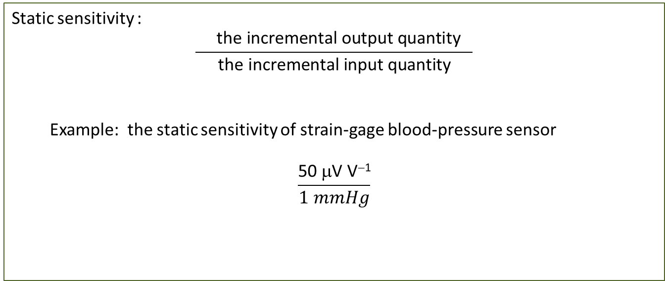
Static sensitivity :
$$\frac{ \text{the} \text{incremental} \text{output} \text{quantity} }{\text{the} \text{incremental} \text{in}\text{put} \text{quantity}}$$
Example: the static sensitivity of strain-gage blood-pressure sensor
$$\frac{\text{50 }\text{μ}\text{V} \text{V}\text{−}\text{1}}{1 mmHg}$$

Slide 22
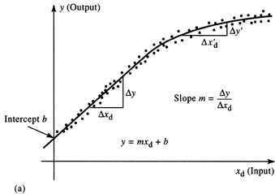
Figure 1.3 (a) Static-sensitivity curve that relates desired input x_{d} to output y. Static sensitivity may be constant for only a limited range of inputs.
Calibration:
y (Output)
(1.9)
Δ x'_{d}
Δ y'
(1.10)
Δ
y
Slope m =
Δy
Δx_{d}
Δx_{d}
Intercept b
y = mx_{d} + b
(1.11)
x_{d} (Input)
(a)

Slide 23
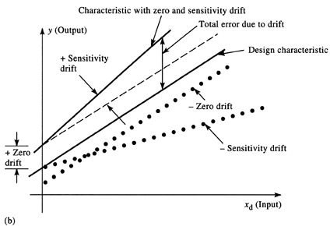
Figure 1.3 (b) Static sensitivity: zero drift and sensitivity drift. Dotted lines indicate that zero drift and sensitivity drift can be negative.
zero drift; sensitivity drift
Characteristic with zero and sensitivity drift
y (Output)
Total error due to drift
+ Sensitivity
drift
− Zero drift
+ Zero
drift
− Sensitivity drift
x_{d} (Input)
(b)

Slide 24
Linearity
Definition of linearity:
x₁
Linear
y₁
(x₁ + x₂)
Linear
(y₁ + y₂)
system
system
and
and
x₂
Linear
y₂
Kx₁
Linear
Ky₁
system
system

Slide 25
Figure 1.4 (a) Basic definition of linearity for a system or element. The same linear system or element is shown four times for different inputs. (b) A graphical illustration of independent nonlinearity equals ±A% of the reading, or ±B% of full scale, whichever is greater (that is, whichever permits the larger error).
Specify the nonlinearity in terms of
the full range → B%
the reading → A%
(a)
Least-squares
straight line
y (Output)
B% of full scale
A% of reading
Overall tolerance band
x_{d} (Input)
Point at which
A% of reading = B% of full scale
(b)

Slide 26
(Generalized) input impedance Z_{x}
(1.12)
(1.13)

Slide 27
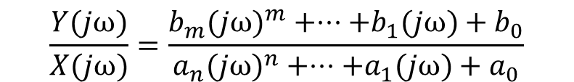

1.10 Generalized Dynamic Characteristics
Fortunately, many engineering instruments can be described by:
Ordinary linear differential equation with constant coefficients
$$a_{n}\frac{d^{n}y}{dt^{n}}+⋅⋅⋅+a_{1}\frac{dy}{dt}+a_{0}y(t)=b_{m}\frac{d^{m}x}{dt^{m}}+⋅⋅⋅+b_{1}\frac{dx}{dt}+b_{0}x(t)$$
(1.14)
$$The differential operator D^{k}=d^{k}()/dt^{k}$$
$$\left(a_{n}D^{n}+⋅⋅⋅+a_{1}D+a_{0}\right)y(t)=\left(b_{m}D^{m}+⋅⋅⋅+b_{1}D+b_{0}\right)x(t)$$
The operational transfer function:
(1.15)
$$\frac{y(D)}{x(D)}=\frac{b_{m}D^{m}+⋅⋅⋅+b_{1}D+b_{0}}{a_{n}D^{n}+⋅⋅⋅+a_{1}D+a_{0}}$$
(1.16)
The frequency transfer function:
$$\frac{Y(jω)}{X(jω)}=\frac{b_{m}(jω)^{m}+⋅⋅⋅+b_{1}(jω)+b_{0}}{a_{n}(jω)^{n}+⋅⋅⋅+a_{1}(jω)+a_{0}}$$
(1.17)

Slide 28
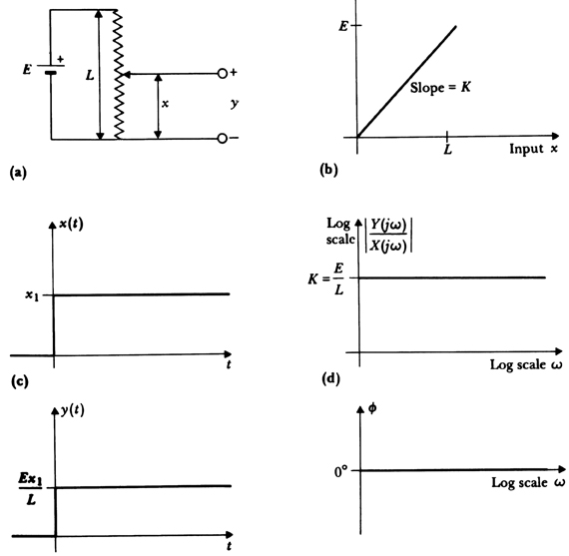
Figure 1.5 (a) A linear potentiometer, an example of a zero-order system.
(b) Linear static characteristic for this system.
(c) Step response is proportional to input.
(d) Sinusoidal frequency response is constant with zero phase shift.
Zero-order instrument

Slide 29
(1.18)
(1.19)

Slide 30
Figure 1.6 (a) A low-pass RC filter, an example of a first-order instrument.
(b) Static sensitivity for constant inputs.
(c) Step response for larger time constants (τ_{L}) and small time constants (τ_{S}).
(d) Sinusoidal frequency response for large and small time constants.
First-order instrument
Output y(t)
R
Static sensitivity
+
+
Slope =
K
= 1
x(t)
C
y(t)
−
−
Input x(t)
(a)
(b)
x(t)
Log
Y (jω)
scale
X (jω)
1
y(t)
1.0
0.707
τ_{S}
τ_{L}
t
ω_{L}
ω_{S}
Log scale ω
y(t)
φ
Step response of First-order
1
0°
τ_{S}
Log scale ω
0.63
τ_{L}
− 45°
τ_{S}
τ_{L}
−90°
t
(c)
(d)

Slide 31

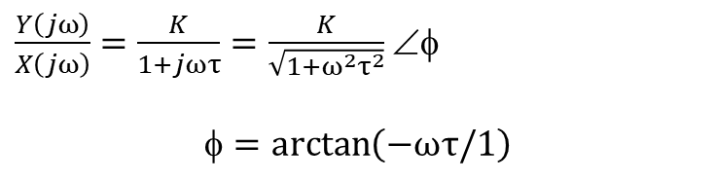

$$a_{1}\frac{dy(t)}{dt}+a_{0}y(t)=b_{0}x(t)$$
(1.20)
$$\left(\text{τD}+1\right)y(t)=Kx(t)$$
(1.21)
$$\frac{y(D)}{x(D)}=\frac{K}{1+τD}$$
(1.22)
$\frac{Y\left(jω\right)}{X\left(jω\right)}=\frac{K}{1+jωτ}=\frac{K}{\sqrt{1+ω^{2}τ^{2}}}$ ∠φ
$$=\arctan\left(−ω\text{τ}\text{/}1\right)$$
(1.23)
$$Step response y\left(t\right)=K\left(1−e^{−t/τ}\right)$$
(1.24)

Slide 32
Figure 1.7
(a) Force-measuring spring scale, an example of a second-order instrument.
(b) Static sensitivity.
(c) Step response for overdamped case, ζ = 2; critically damped case, ζ = 1; underdamped case, ζ = 0.5.
(d) Sinusoidal steady-state frequency response, ζ = 2, ζ = 1, ζ = 0.5.
Second-order instrument
Output
y
(
t
)
Output
displacement
Input
Force x(t)
y(t)
0
Slope K =
1
K_{s}
(b)
Input x(t)
(a)
Y (jω)
Resonance
x(t)
Log
X (jω)
scale
1
K
2
1
0.5
ω_{n}
Log scale ω
t
φ
ω_{n}
y(t)
0°
Log scale ω
y_{n}
y_{n + 1}
2
0.5
1
-90°
1
K_{s}
1
0.5
2
-180°
t
(c)
(d)

Slide 33
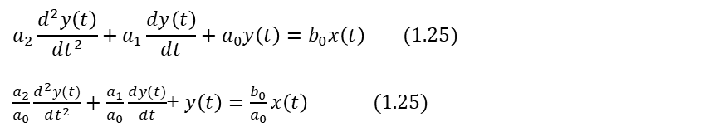


$$a_{2}\frac{d^{2}y\left(t\right)}{dt^{2}}+a_{1}\frac{dy\left(t\right)}{dt}+a_{0}y\left(t\right)=b_{0}x\left(t\right) (1.25)$$
$\frac{a_{2}}{a_{0}}\frac{d^{2}y(t)}{dt^{2}}+$ $\frac{a_{1}}{a_{0}}\frac{dy(t)}{dt}$+ $y\left(t\right)=\frac{b_{0}}{a_{0}}x\left(t\right) (1.25)$
$$\left[\frac{D^{2}}{ω_{n}^{2}}+\frac{2ζD}{ω_{n}}+1\right]y\left(t\right)=Kx\left(t\right) (1.26)$$
where
$$ζ=\frac{a_{1}}{2\sqrt{a_{0}a_{2}}}=\frac{a_{1}/a_{0}}{2\sqrt{a_{2}{/a}_{0}}}= \text{damping} \text{ratio}\text{, }\text{dimensionless}$$
(1.27)
(1.28)

Slide 34
(1.29)
(1.30)
(1.31)
(1.32)
Overdamped,
(1.33)
Critically damped,
(1.34)
Underdamped,
(1.35)

Slide 35
and
(1.36)
(1.37)
(1.38)
(1.39)
(1.40)

Slide 36
1.11 Design Criteria

Slide 37
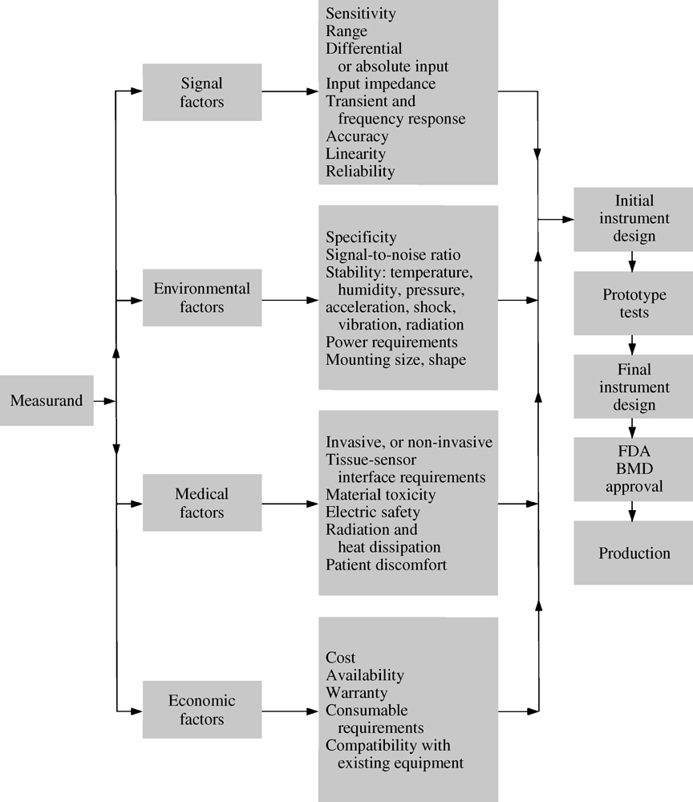
Figure 1.8 Design process for medical instruments
Premarket Approval (PMA)
What is “specificity”?
Why “acceleration”?
Chapter 14
BMD = 骨質密度 (Bone Mineral Density) ?
BMD = bacitracin methylene disalicylate
(桿菌呔次甲基)

Slide 38
1.12 Commercial Medical Instrumentation Development Process

Slide 39
1.13 Regulation of Medical Devices

Slide 40
Purpose: To ensure the safety and efficacy of new medical devices prior to marketing of the device
1930s | Federal Food, Drug, and Cosmetics Act
May 28, 1976 | Medical Device Amendments | Classes I, II, III 7 Categories
1990 | Safe Medical Devices Act | Further amendments

Slide 41
FDA Regulation
Purpose: | To assure the safety and effectiveness of medical devices.
Measure (手段) | Regulation
Basis: | The risks associated with the device
Regulatory classes: | class I, class II, or class III.
Regulation: | General Controls Special Controls Premarket Approval (PMA)
Summary:
# The FDA classification is a risk-based device classification system for medical devices.
# Each device is assigned to one of three regulatory classes: Class I, Class II or Class III,
# Each class requires different level of control necessary to provide reasonable assurance of its safety and effectiveness.

Slide 42
Class & Regulatory Control
Class | Risk | Control (Source: the textbook) | Example (Ref: https://www.qualio.com/blog/fda-medical-device-classes-differences)
Class I | low to moderate | General controls Most devices are exempt from Premarket Notification 510(k) (substantial equivalence to a predicate device) | Electric Toothbrush, Tongue Depressor Oxygen Mask, Reusable Surgical Scalpel, Bandages, Hospital Beds
Class II | moderate to high | General controls Special Controls (Most devices require) Premarket notification 510 (k) | Catheters (導管), Blood Pressure Cuffs, Pregnancy Test Kits, Syringes (注射器), Blood Transfusion Kits, Contact Lenses, Surgical Gloves, Absorbable Sutures (縫線)
Class III | high | General controls (Most devices require) Premarket Approval (PMA) | Breast implants, Pacemakers, Defibrillators, High-frequency ventilators, Cochlear implants, Fetal blood sampling monitors, Implanted prosthetics
A high risk device
= supports or sustains human life,
is of substantial importance in preventing impairment of human health,
or presents a potential, unreasonable risk of illness or injury

Slide 43
Regulatory Control
General Controls | include provisions that relate to adulteration(粗劣品; 攙假貨); misbranding; device registration and listing; premarket notification; banned devices; notification, including repair, replacement, or refund; records and reports; restricted devices; and good manufacturing practices.
Special control | Performance standards Postmarket surveillance Patient registries Special labeling requirements Premarket data requirements Guidelines
Premarket Approval (PMA) | The PMA contains sufficient valid scientific evidence to assure that the device is safe and effective for its intended use(s).

Slide 44
Premarket Approval (PMA)
What is a “Premarket Approval (PMA) application”?
Ans: A scientific, regulatory documentation to FDA to demonstrate the safety and effectiveness of the Class III device.
What is the quality requirement for a PMA application?
Ans: scientifically sound and presented in a well-organized format.
Class III devices：
those that support or sustain human life,
are to prevent impairment of human health,
present a potential, unreasonable risk of illness or injury.

Slide 45
Premarket notification 510 (k)
A 510(k) is a premarket submission made to FDA
to demonstrate that the device to be marketed is as safe and effective,
that is, substantially equivalent, to a legally marketed device.
(Source: https://www.fda.gov/medical-devices/premarket-submissions-selecting-and-preparing-correct-submission/premarket-notification-510k)
Ref: https://www.qualio.com/blog/fda-medical-device-classes-differences

